Slide 1
Probabilistic Models for Supervised Learning (contd)
CS771: Introduction to Machine Learning
Piyush Rai

Slide 2
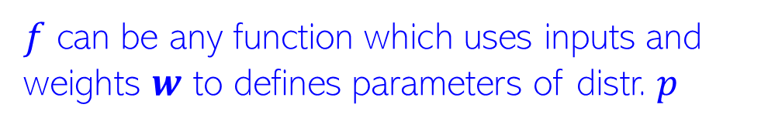

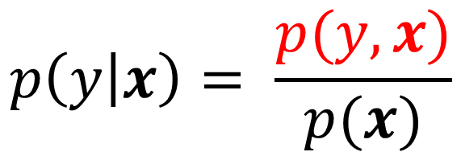

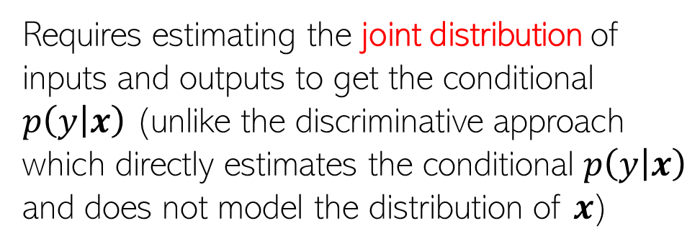
Recap: Prob. Models for Supervised Learning
Goal: Learn the conditional distribution $p(y|x)$. Broadly, two approaches
Discriminative Approach
Generative Approach
$$p\left(y | x\right)=p(y|f\left(x,w\right))$$
$$p\left(y | x\right)= \frac{p(y,x)}{p(x)}$$
$f$ can be any function which uses inputs and weights $w$ to defines parameters of distr. $p$
Requires estimating the joint distribution of inputs and outputs to get the conditional $p\left(y | x\right)$ (unlike the discriminative approach which directly estimates the conditional $p\left(y | x\right)$ and does not model the distribution of $x$)
Some examples
$$p\left(y | x\right)=𝒩(y|w^{⊤}x,β^{−1})$$
$$p\left(y | x\right)=Bernoulli(y|σ(w^{⊤}x))$$

Slide 3








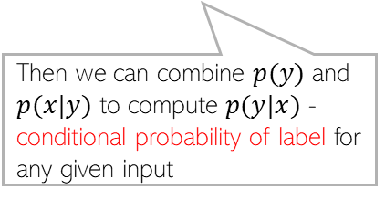

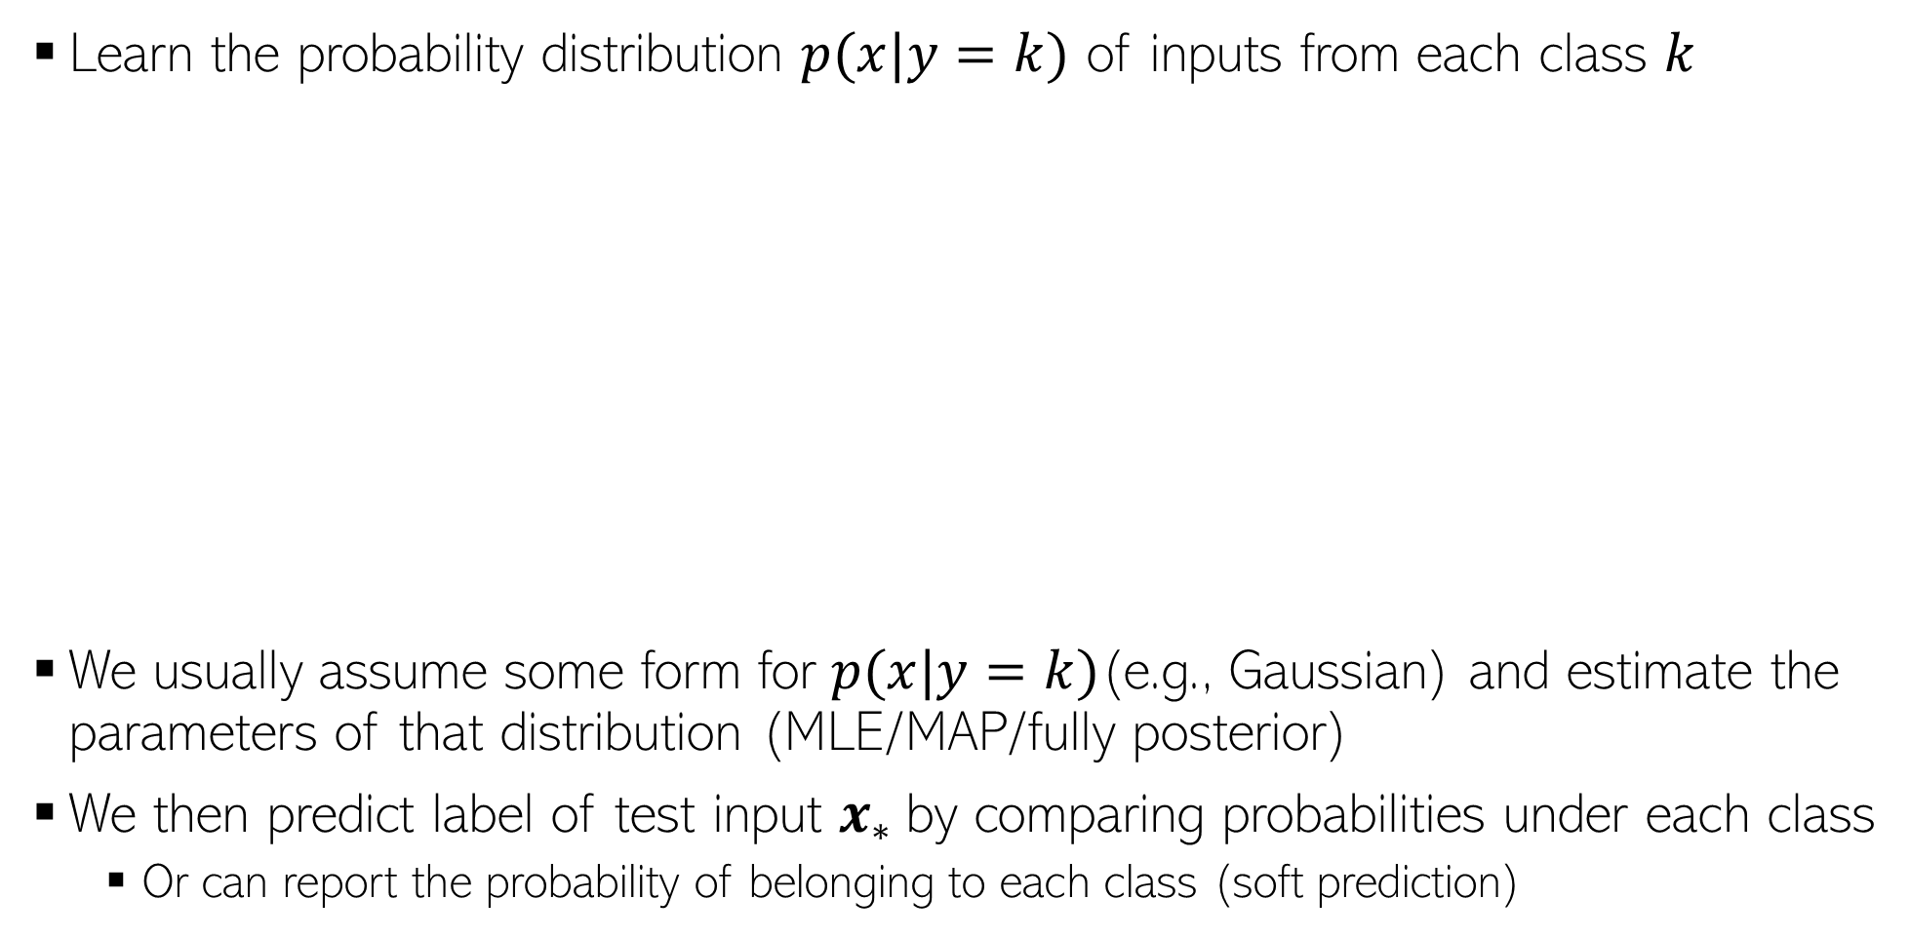


Generative Classification: A Basic Idea
Learn the probability distribution $p(x|y=k)$ of inputs from each class $k$
We usually assume some form for $p(x|y=k)$(e.g., Gaussian) and estimate the parameters of that distribution (MLE/MAP/fully posterior)
We then predict label of test input $x_{∗}$by comparing probabilities under each class
Or can report the probability of belonging to each class (soft prediction)
Yes. Possible with generative model. We can do it by estimating class marginal probabilities $p(y)$ (class proportions in the training data) in our model
What if I expect that the green class is more likely for a test input because the training data also had more green examples?
$$p(x|"red")$$
Then we can combine $p(y)$ and $p(x|y)$ to compute $p(y|x)$ - conditional probability of label for any given input
$$p(x_{∗}|class)$$
$$p(x_{∗}|class)$$
Can I incorporate this knowledge?
$$p(x|"green")$$
$$p(x_{∗}|class)$$
Going to talk about this next
$$x_{∗}$$
$$x_{∗}$$
$$x_{∗}$$

Slide 4
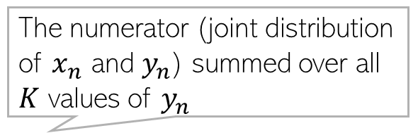
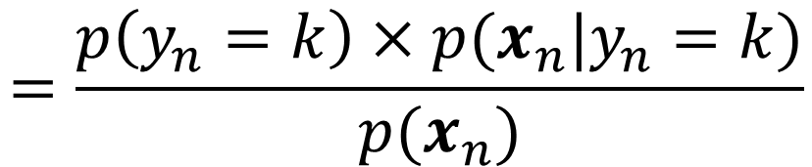
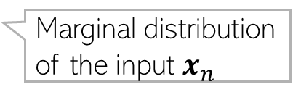
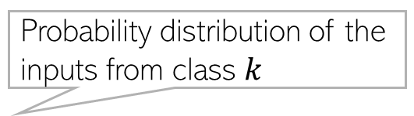
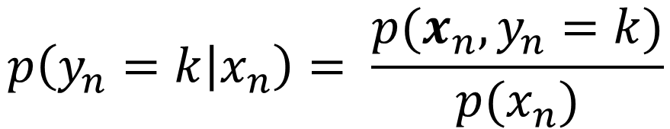

Generative Classification
Suppose we have training data $\{{\left(x_{n},y_{n}\right)\}}_{n=1}^{N}$ from $K$ classes
The conditional probability of label $y_{n}$ given the input $x_{n}$
We use the training data to estimate the class-marginal and class-conditionals
Known as the “class-conditional” distribution
$$p\left(y_{n}=k | x_{n}\right)= \frac{p(x_{n},y_{n}=k)}{p(x_{n})}$$
Probability distribution of the inputs from class $k$
Known as “class-marginal” or “class-prior” distribution
The numerator (joint distribution of $x_{n}$ and $y_{n}$) summed over all $K$ values of $y_{n}$
$$=\frac{p\left(y_{n}=k\right)×p(x_{n}|y_{n}=k)}{p(x_{n})}$$
Marginal distribution of just the labels (not looking at the inputs) – Bernoulli/multinoulli
Marginal distribution of the input $x_{n}$

Slide 5
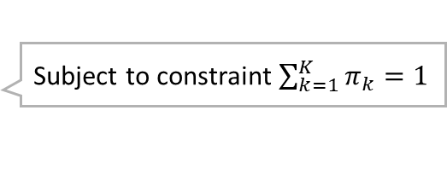
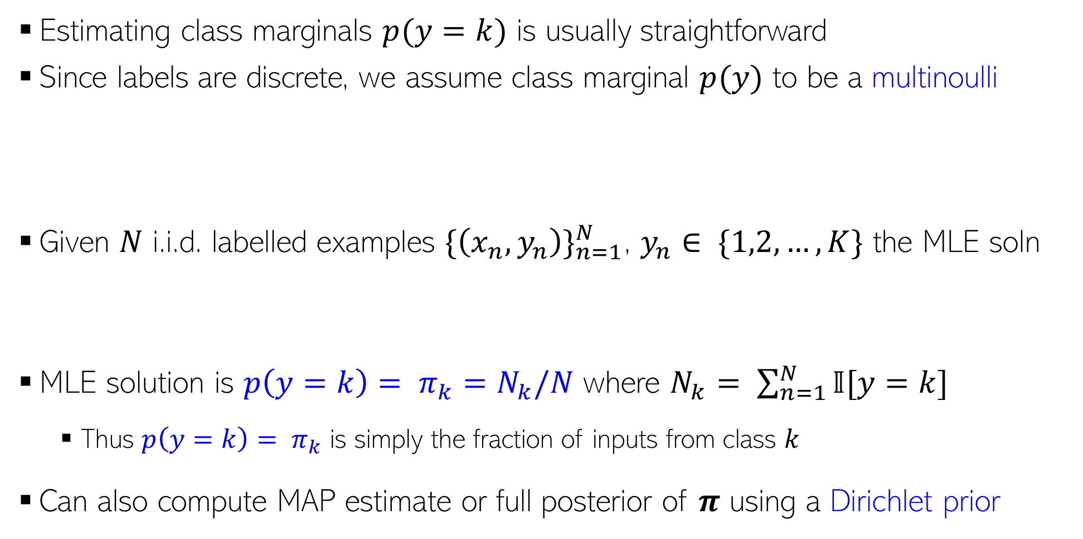
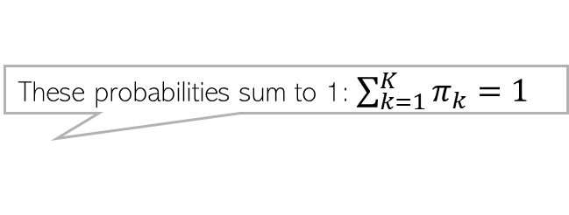
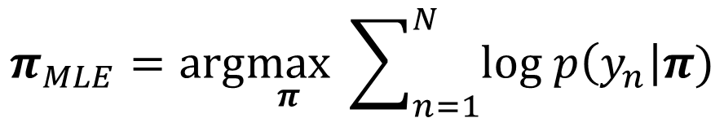

Estimating Class Marginals
If only two classes, assume Bernoulli
Estimating class marginals $p(y=k)$ is usually straightforward
Since labels are discrete, we assume class marginal $p(y)$ to be a multinoulli
Given $N$ i.i.d. labelled examples ${\{\left(x_{n},y_{n}\right)\}}_{n=1}^{N}$, $y_{n}∈ \{1,2,…,K\}$ the MLE soln
MLE solution is ${p\left(y=k\right)= π}_{k}=N_{k}/N$ where $N_{k}= \sum_{n=1}^{N}{𝕀[y=k]}$
Thus ${p\left(y=k\right)= π}_{k}$ is simply the fraction of inputs from class $k$
Can also compute MAP estimate or full posterior of $π$ using a Dirichlet prior
These probabilities sum to 1: $\sum_{k=1}^{K}{π_{k}=1}$
$$π_{k} = p(y=k)$$
$p\left(y | π\right)=multinoulli(y|π_{1},π_{2},…,π_{K})= \prod_{k=1}^{K}{π_{k}^{𝕀[y=k]}}$
$$π_{MLE}=arg\max_{π} \sum_{n=1}^{N}{log p\left(y_{n}\right|π)}$$
Subject to constraint $\sum_{k=1}^{K}{π_{k}=1}$

Slide 6
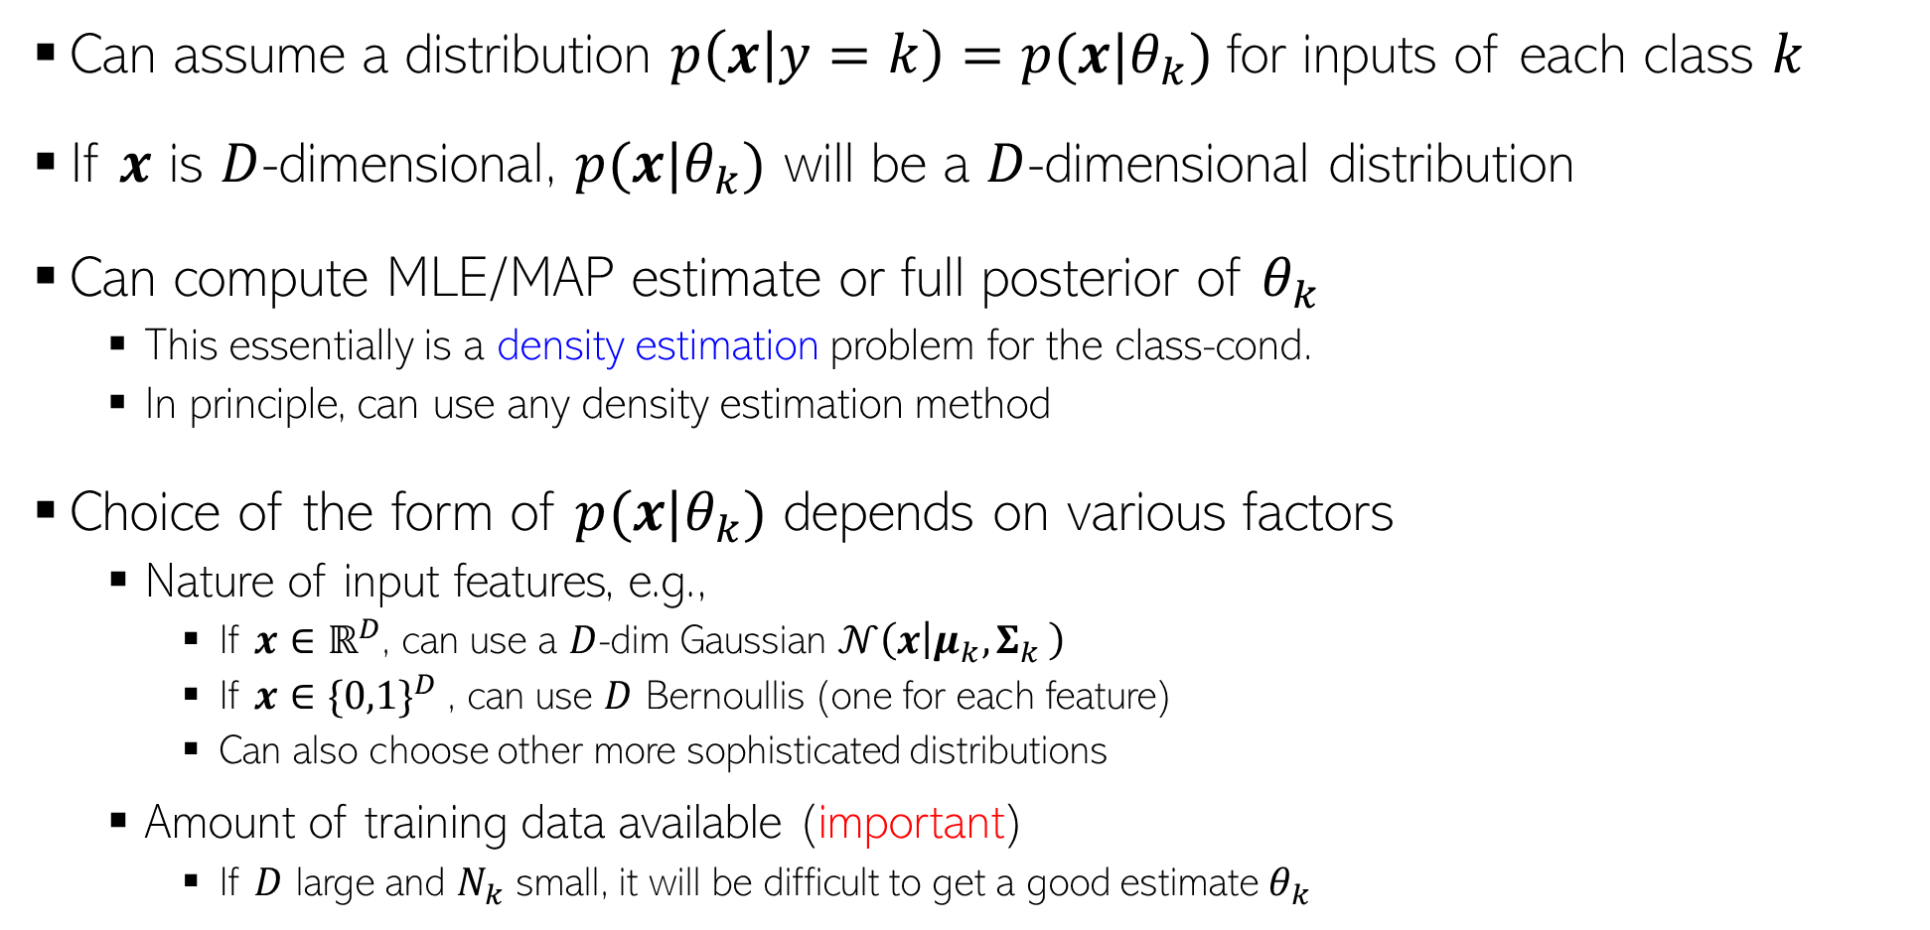
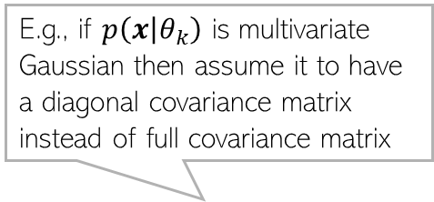

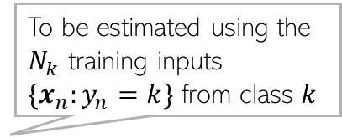
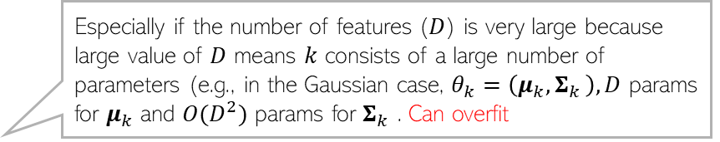
Estimating Class-Conditionals
To be estimated using the $N_{k}$ training inputs $\{x_{n}:y_{n}=k\}$ from class $k$
Can assume a distribution $p\left(x | y=k\right)=p(x|θ_{k})$for inputs of each class $k$
If $x$ is $D$-dimensional, $p(x|θ_{k})$ will be a $D$-dimensional distribution
Can compute MLE/MAP estimate or full posterior of $θ_{k}$
This essentially is a density estimation problem for the class-cond.
In principle, can use any density estimation method
Choice of the form of $p(x|θ_{k})$ depends on various factors
Nature of input features, e.g.,
If $x∈ℝ^{D}$, can use a $D$-dim Gaussian $𝒩\left(x | μ_{k}{,Σ}_{k}\right)$
If $x∈{\{0,1\}}^{D}$, can use $D$ Bernoullis (one for each feature)
Can also choose other more sophisticated distributions
Amount of training data available (important)
If $D$ large and $N_{k}$ small, it will be difficult to get a good estimate $θ_{k}$
E.g., if $p\left(x | θ_{k}\right)$ is multivariate Gaussian then assume it to have a diagonal covariance matrix instead of full covariance matrix
Such assumptions greatly reduce the number of parameters to be estimated
In such cases, we may need to regularize $θ_{k}$ or make some simplifying assumptions on $p\left(x | θ_{k}\right)$, such as features being conditionally independent given class e.g., $p\left(x | θ_{k}\right)= \prod_{d=1}^{D}{p(x_{d}|θ_{kd})}$ - naïve Bayes
Especially if the number of features ($D$) is very large because large value of $D$ means $k$ consists of a large number of parameters (e.g., in the Gaussian case, $θ_{k}=\left(μ_{k}{,Σ}_{k}\right), D$ params for $μ_{k}$ and $O(D^{2})$ params for $Σ_{k}$ . Can overfit

Slide 7


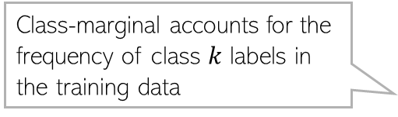
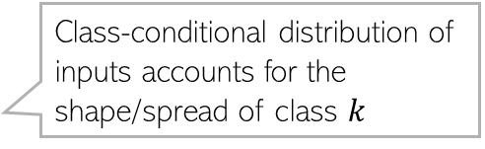

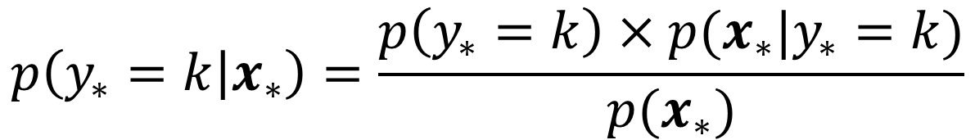

Generative Classification: At Test Time
Recall the form of the conditional distribution of the label
If we assume the class-marginal to be uniform ($p\left(y_{∗}=k\right)=1/K)$ then
The most likely label is $y_{∗}= {argmax}_{k∈\{1,2,…,K\}} p\left(y_{∗}=k | x_{∗}\right)$
Class-marginal accounts for the frequency of class $k$ labels in the training data
Class-conditional distribution of inputs accounts for the shape/spread of class $k$
$$p\left(y_{∗}=k | x_{∗}\right)=\frac{p\left(y_{∗}=k\right)×p(x_{∗}|y_{∗}=k)}{p(x_{∗})}$$
$$∝p\left(y_{∗}=k\right)×p(x_{∗}|y_{∗}=k)$$
Probability of $x_{∗}$ belonging to class $k$ is proportional to the fraction of training inputs from class $k$ times the probability of $x_{∗}$ under the distribution of inputs from class $k$
$$∝ {\hat{π}}_{k}×p(x_{∗}|{\hat{θ}}_{k})$$
$$p\left(y_{∗}=k | x_{∗}\right)∝p(x_{∗}|{\hat{θ}}_{k})$$

Slide 8
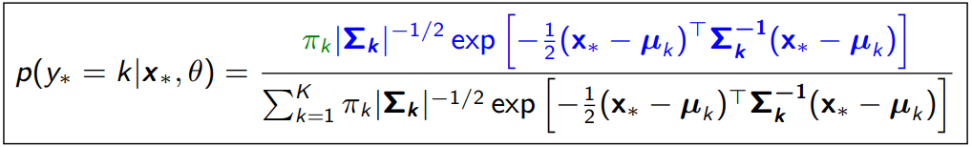
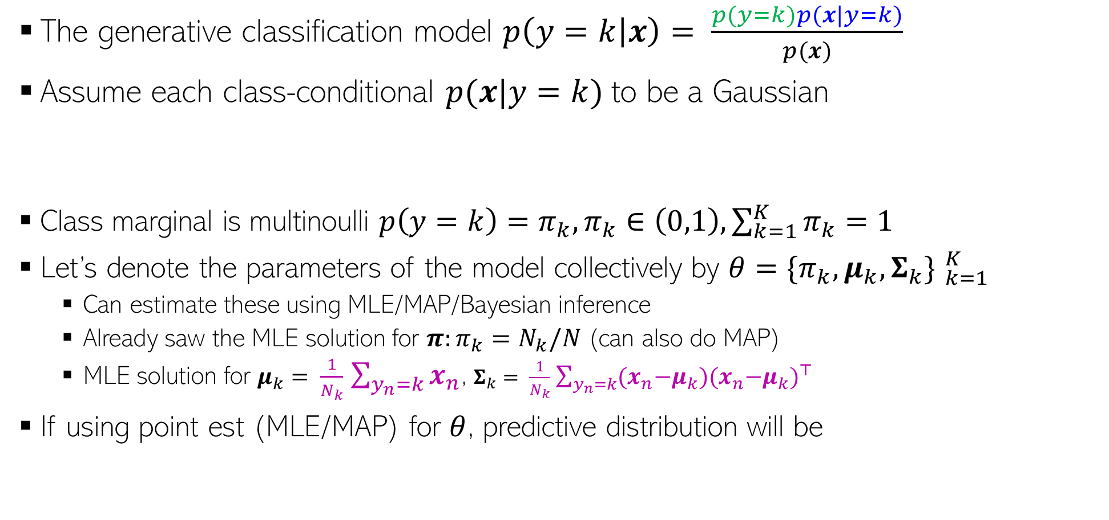
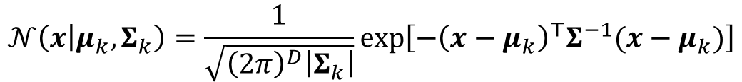
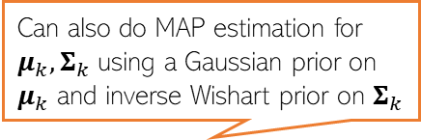
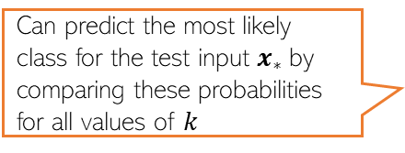
Gen. Classifn. using Gaussian Class-conditionals
A benefit of modeling each class by a distribution (recall that LwP had issues)
The generative classification model $p\left(y=k | x\right)= \frac{p(y=k)p(x|y=k)}{p(x)}$
Assume each class-conditional $p(x|y=k)$to be a Gaussian
Class marginal is multinoulli $p\left(y=k\right)=π_{k}, π_{k}∈\left(0,1\right), \sum_{k=1}^{K}{π_{k}}=1$
Let’s denote the parameters of the model collectively by $θ={\{π_{k},μ_{k},Σ_{k}\} }_{k=1}^{K}$
Can estimate these using MLE/MAP/Bayesian inference
Already saw the MLE solution for $π:π_{k}=N_{k}/N$ (can also do MAP)
MLE solution for $μ_{k}= \frac{1}{N_{k}}$ $\sum_{y_{n}=k}{x_{n}}$, $Σ_{k}= \frac{1}{N_{k}}$ $\sum_{y_{n}=k}{{{(x}_{n}−μ_{k}){(x}_{n}−μ_{k})}^{⊤}}$
If using point est (MLE/MAP) for $θ$, predictive distribution will be
Since the Gaussian’s covariance models its shape, we can learn the shape of each class ☺
$$𝒩\left(x | μ_{k},Σ_{k}\right)=\frac{1}{\sqrt{{\left(2π\right)}^{D}\left|Σ_{k}\right|}}exp\left[−{\left(x−μ_{k}\right)}^{⊤}Σ^{−1}(x−μ_{k})\right]$$
Can also do MAP estimation for $μ_{k},Σ_{k}$ using a Gaussian prior on $μ_{k}$ and inverse Wishart prior on $Σ_{k}$
Exercise: Try to derive this. I will provide a separate note containing the derivation
Can predict the most likely class for the test input $x_{∗}$by comparing these probabilities for all values of $k$
Note that the exponent has a Mahalanobis distance like term. Also, accounts for the fraction of training examples in class k

Slide 9
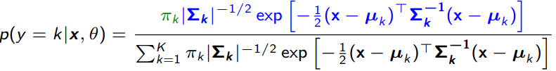
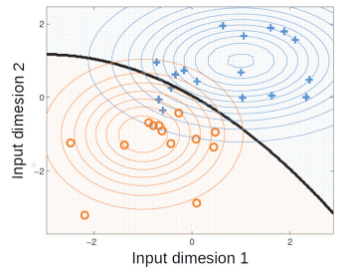

Decision Boundary with Gaussian Class-Conditional
As we saw, the prediction rule when using Gaussian class-conditional
The decision boundary between any pair of classes will be a quadratic curve
Reason: For any two classes $k$ and $k^{′}$ at the decision boundary, we will have $p\left(y=k | x,θ\right)=p(y=k^{′}|x,θ)$. Comparing their logs and ignoring terms that don’t contain $x$, can easily see that
Decision boundary contains all inputs $x$ that satisfy the above
This is a quadratic function of $x$ (this model is sometimes referred to Quadratic Discriminant Analysis)

Slide 10
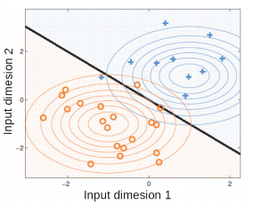
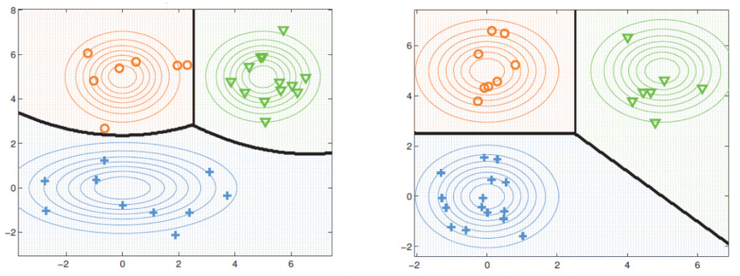

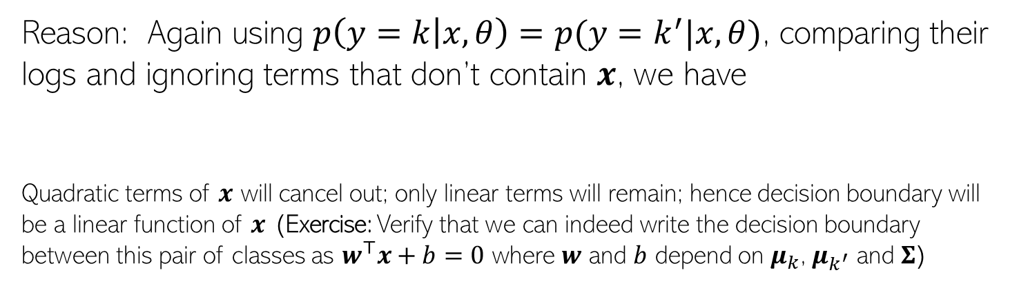
Decision Boundary with Gaussian Class-Conditional
Assume all classes are modeled using the same covariance matrix $Σ_{k}=Σ, ∀k$
In this case, the decision boundary b/w any pair of classes will be linear
Reason: Again using $p\left(y=k | x,θ\right)=p(y=k^{′}|x,θ)$, comparing their logs and ignoring terms that don’t contain $x$, we have
Quadratic terms of $x$ will cancel out; only linear terms will remain; hence decision boundary will be a linear function of $x$ (Exercise: Verify that we can indeed write the decision boundary between this pair of classes as $w^{⊤}x+b=0$ where $w$ and $b$ depend on $μ_{k}$, $μ_{k^{′}}$ and $Σ$)
If we assume the covariance matrices of the assumed Gaussian class-conditionals for any pair of classes to be equal, then the learned separation boundary b/w this pair of classes will be linear; otherwise, quadratic as shown in the figure on left

Slide 11

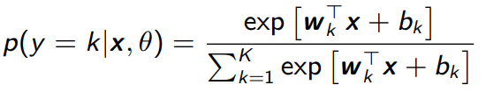



A Closer Look at the Linear Case
For the linear case (when $Σ_{k}=Σ, ∀k$), the class conditional probability
Expanding further, we can write the above as
Therefore, the above class posterior probability can be written as
The above has exactly the same form as softmax classification(thus softmax is a special case of a generative classification model with Gaussian class-conditionals)
If all Gaussians class-cond have the same covariance matrix (basically, of all classes are assumed to have the same shape)

Slide 12


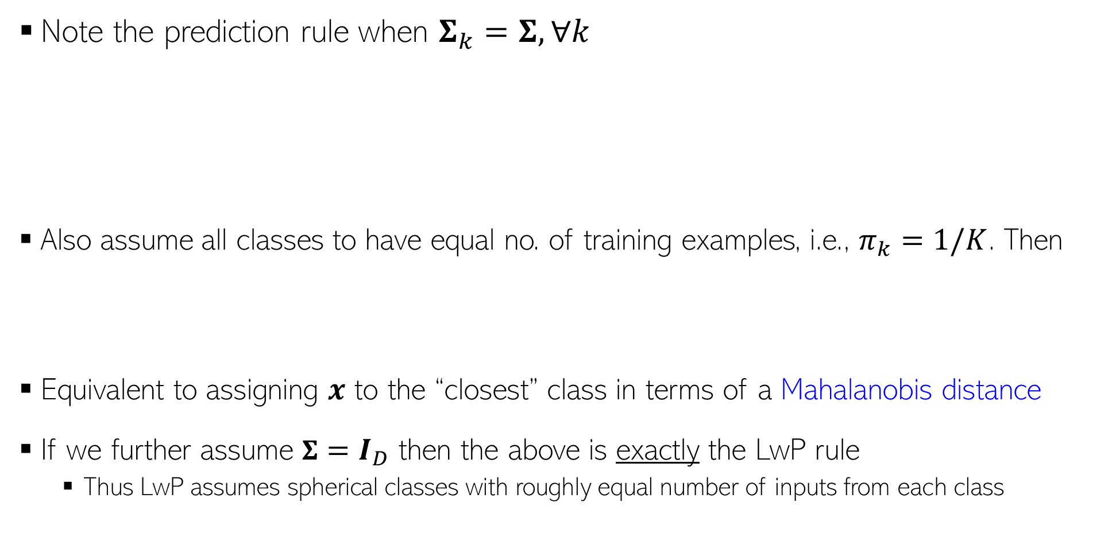
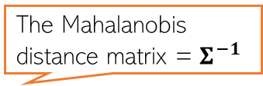
A Very Special Case: LwP Revisited
Note the prediction rule when $Σ_{k}=Σ, ∀k$
Also assume all classes to have equal no. of training examples, i.e., $π_{k}=1/K$. Then
Equivalent to assigning $x$ to the “closest” class in terms of a Mahalanobis distance
If we further assume $Σ=I_{D}$ then the above is exactly the LwP rule
Thus LwP assumes spherical classes with roughly equal number of inputs from each class
The Mahalanobis distance matrix = $Σ^{−1}$

Slide 13
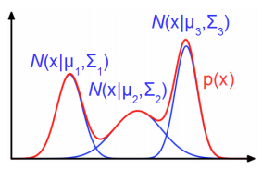
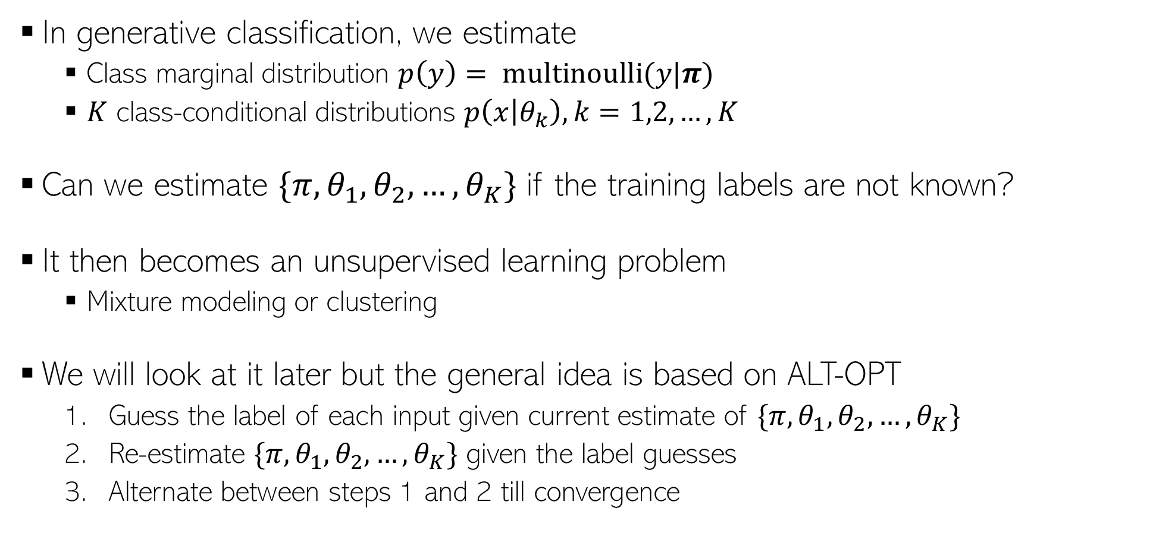
Unsupervised Generative Classification
In generative classification, we estimate
Class marginal distribution $p\left(y\right)= multinoulli(y|π)$
$K$ class-conditional distributions $p\left(x | θ_{k}\right), k=1,2,…, K$
Can we estimate $\{π, θ_{1},θ_{2},…, θ_{K}\}$ if the training labels are not known?
It then becomes an unsupervised learning problem
Mixture modeling or clustering
We will look at it later but the general idea is based on ALT-OPT
Guess the label of each input given current estimate of $\{π, θ_{1},θ_{2},…, θ_{K}\}$
Re-estimate $\{π, θ_{1},θ_{2},…, θ_{K}\}$ given the label guesses
Alternate between steps 1 and 2 till convergence

Slide 14

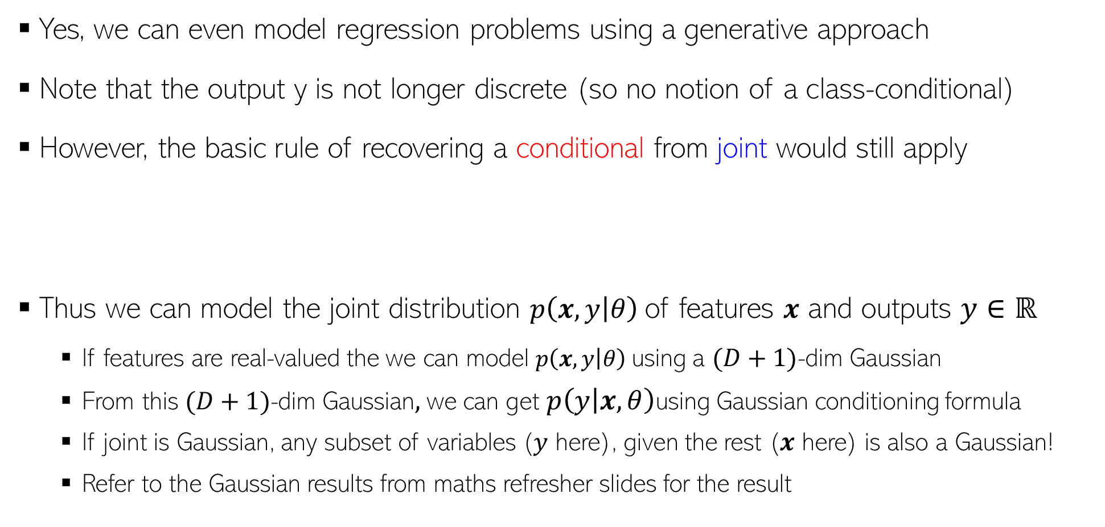
Generative Models for Regression
Yes, we can even model regression problems using a generative approach
Note that the output y is not longer discrete (so no notion of a class-conditional)
However, the basic rule of recovering a conditional from joint would still apply
Thus we can model the joint distribution $p\left(x,y | θ\right)$of features $x$ and outputs $y∈ℝ$
If features are real-valued the we can model $p\left(x,y | θ\right)$using a $(D+1)$-dim Gaussian
From this $(D+1)$-dim Gaussian$,$we can get $p\left(y | x,θ\right)$using Gaussian conditioning formula
If joint is Gaussian, any subset of variables ($y$ here), given the rest ($x$ here) is also a Gaussian!
Refer to the Gaussian results from maths refresher slides for the result
$$p\left(y | x,θ\right)= \frac{p\left(x,y | θ\right)}{p(x|θ)}$$

Slide 15
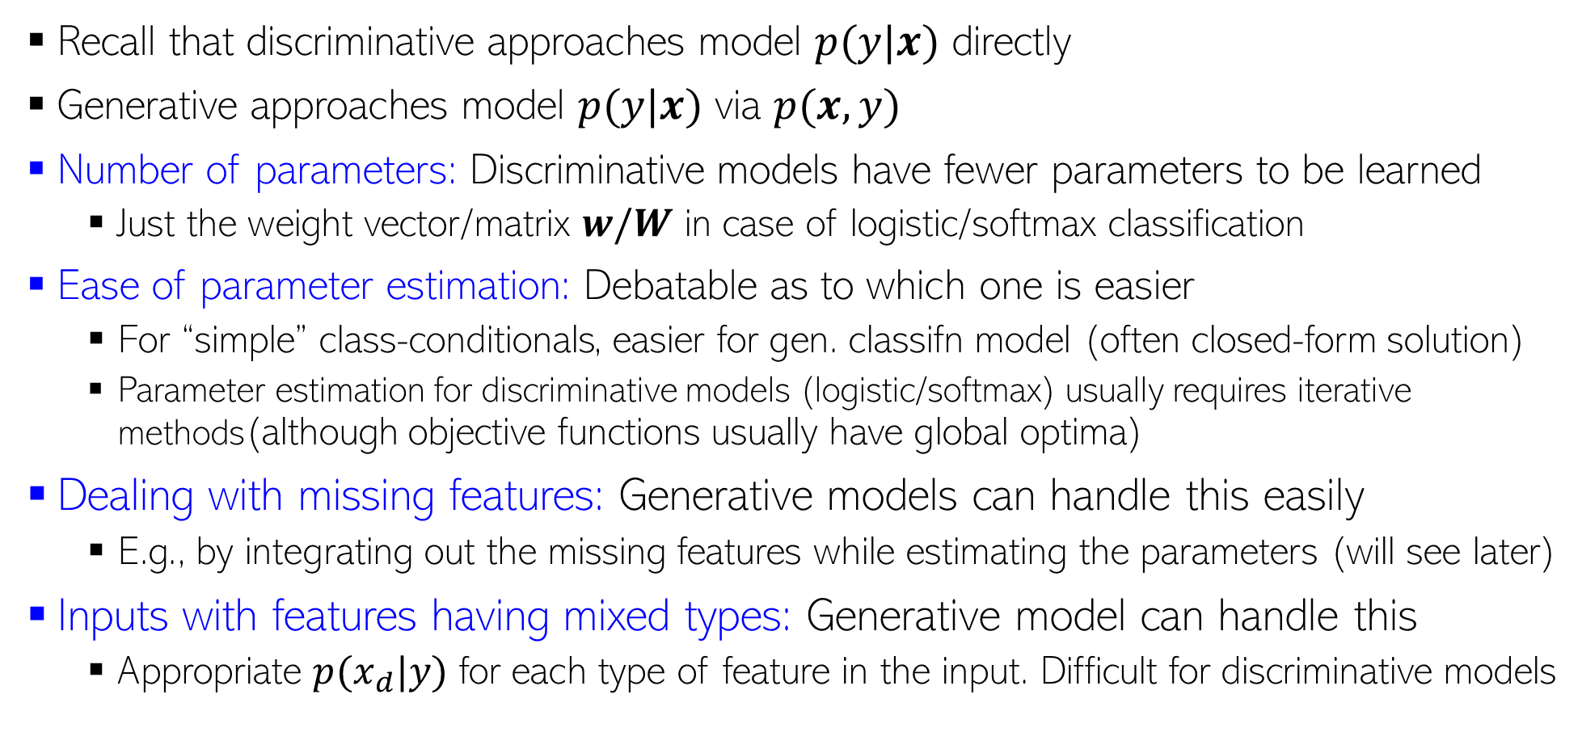
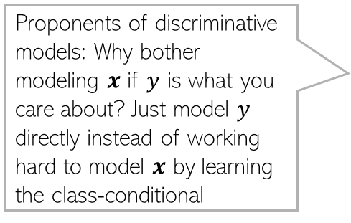
Discriminative vs Generative
Proponents of discriminative models: Why bother modeling $x$ if $y$ is what you care about? Just model $y$ directly instead of working hard to model $x$ by learning the class-conditional
Recall that discriminative approaches model $p(y|x)$ directly
Generative approaches model $p(y|x)$ via $p(x,y)$
Number of parameters: Discriminative models have fewer parameters to be learned
Just the weight vector/matrix $w/W$ in case of logistic/softmax classification
Ease of parameter estimation: Debatable as to which one is easier
For “simple” class-conditionals, easier for gen. classifn model (often closed-form solution)
Parameter estimation for discriminative models (logistic/softmax) usually requires iterative methods(although objective functions usually have global optima)
Dealing with missing features: Generative models can handle this easily
E.g., by integrating out the missing features while estimating the parameters (will see later)
Inputs with features having mixed types: Generative model can handle this
Appropriate $p(x_{d}|y)$ for each type of feature in the input. Difficult for discriminative models

Slide 16
Discriminative vs Generative (Contd)
Leveraging unlabeled data: Generative models can handle this easily by treating the missing labels are latent variables and are ideal for Semi-supervised Learning. Discriminative models can’t do it easily
Adding data from new classes: Discriminative model will need to be re-trained on all classes all over again. Generative model will just require estimating the class-cond of newly added classes
Have lots of labeled training data? Discriminative models usually work very well
Final Verdict? Despite generative classification having some clear advantages, both methods can be quite powerful (the actual choice may be dictated by the problem)
Important to be aware of their strengths/weaknesses, and also the connections between these
Possibility of a Hybrid Design? Yes, Generative and Disc. models can be combined, e.g.,
“Principled Hybrids of Generative and Discriminative Models” (Lassere et al, 2006)
“Deep Hybrid Models: Bridging Discriminative & Generative Approaches” (Kuleshov & Ermon, 2017)

